Slide 1

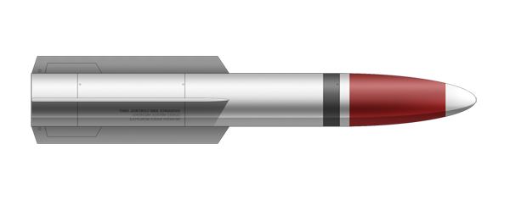
Pip: The Game
P.I.P. : Playable Intergalactic Phallus
A shoot-em-up game with cuhrayzee visuals and a touching soundtrack
A tragic story of a rocketman facing his inner and outer demons
Fun and challenging mechanics that make the player question their skills (and sanity)
Silky smooth 60fps 1080p next-gen cinematic graffix
Introducing for the first time in video game history: controllable phallic space objects
”GOTY of 2016” – paid reviewer
”It just werks” – Hodd Toward
”Straight to greenlight pls” - GabeN

